Slide 1


SMART INDIA HACKATHON 2024
Problem Statement ID : SIH1640
Problem Statement Title-
Theme -
PS Category : Software
Team ID : T098
Team Name : Team Bhoomi Sahayog
Assured Contract Farming System for Stable Market Access
Design a secure, transparent platform for efficient contract farming

Slide 2





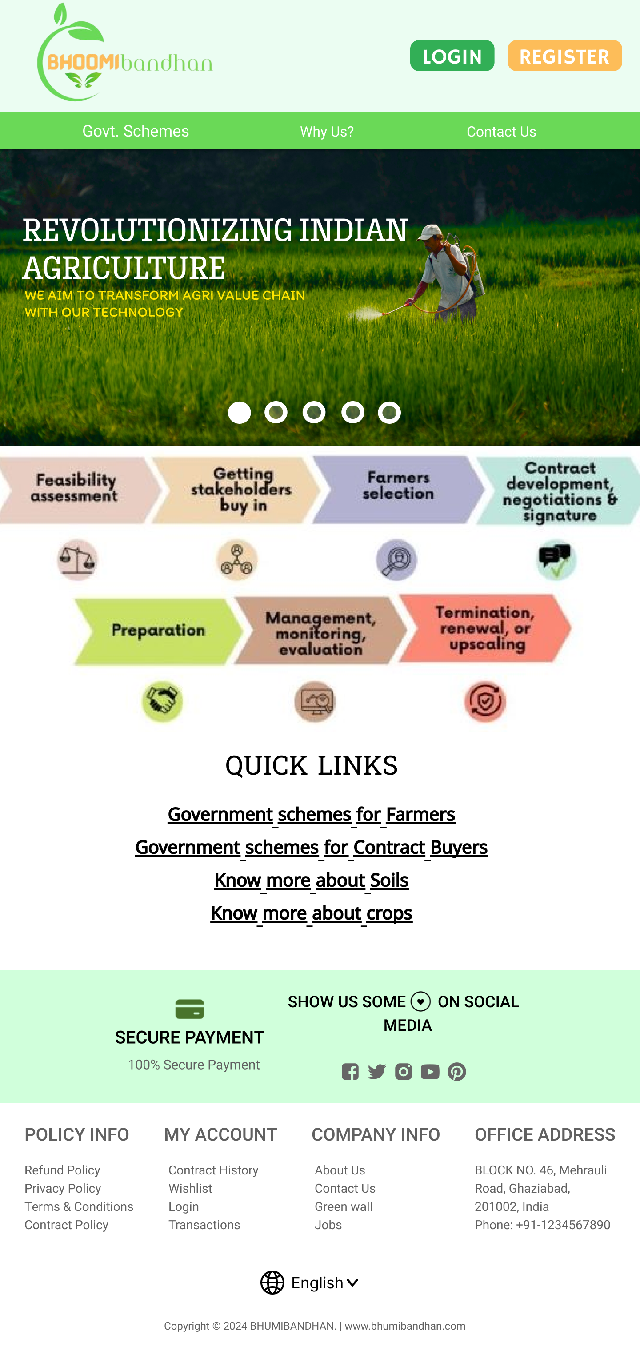
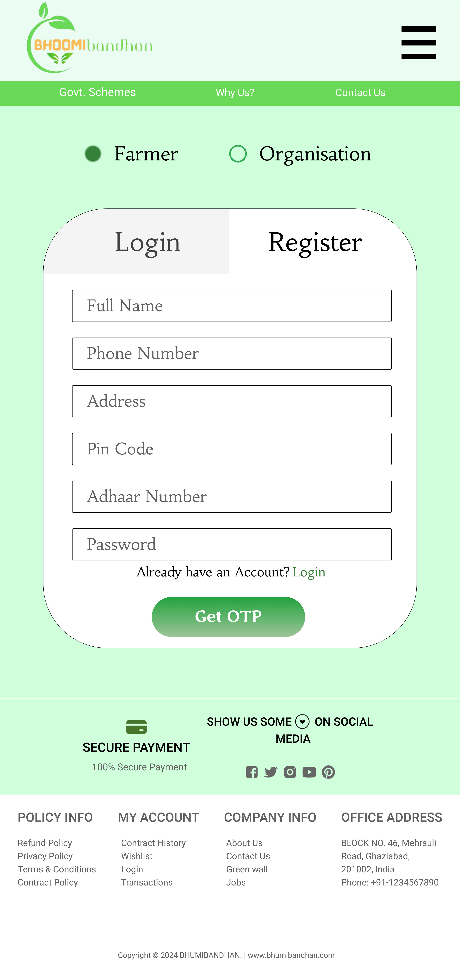
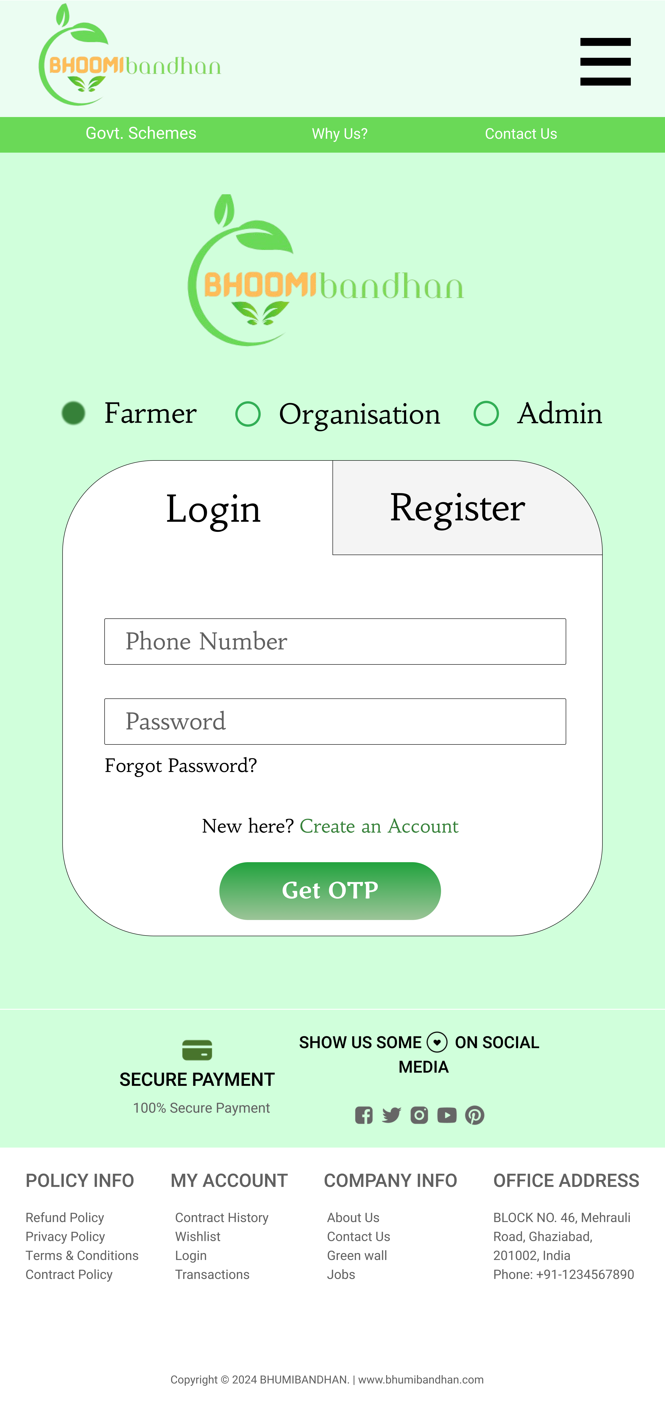
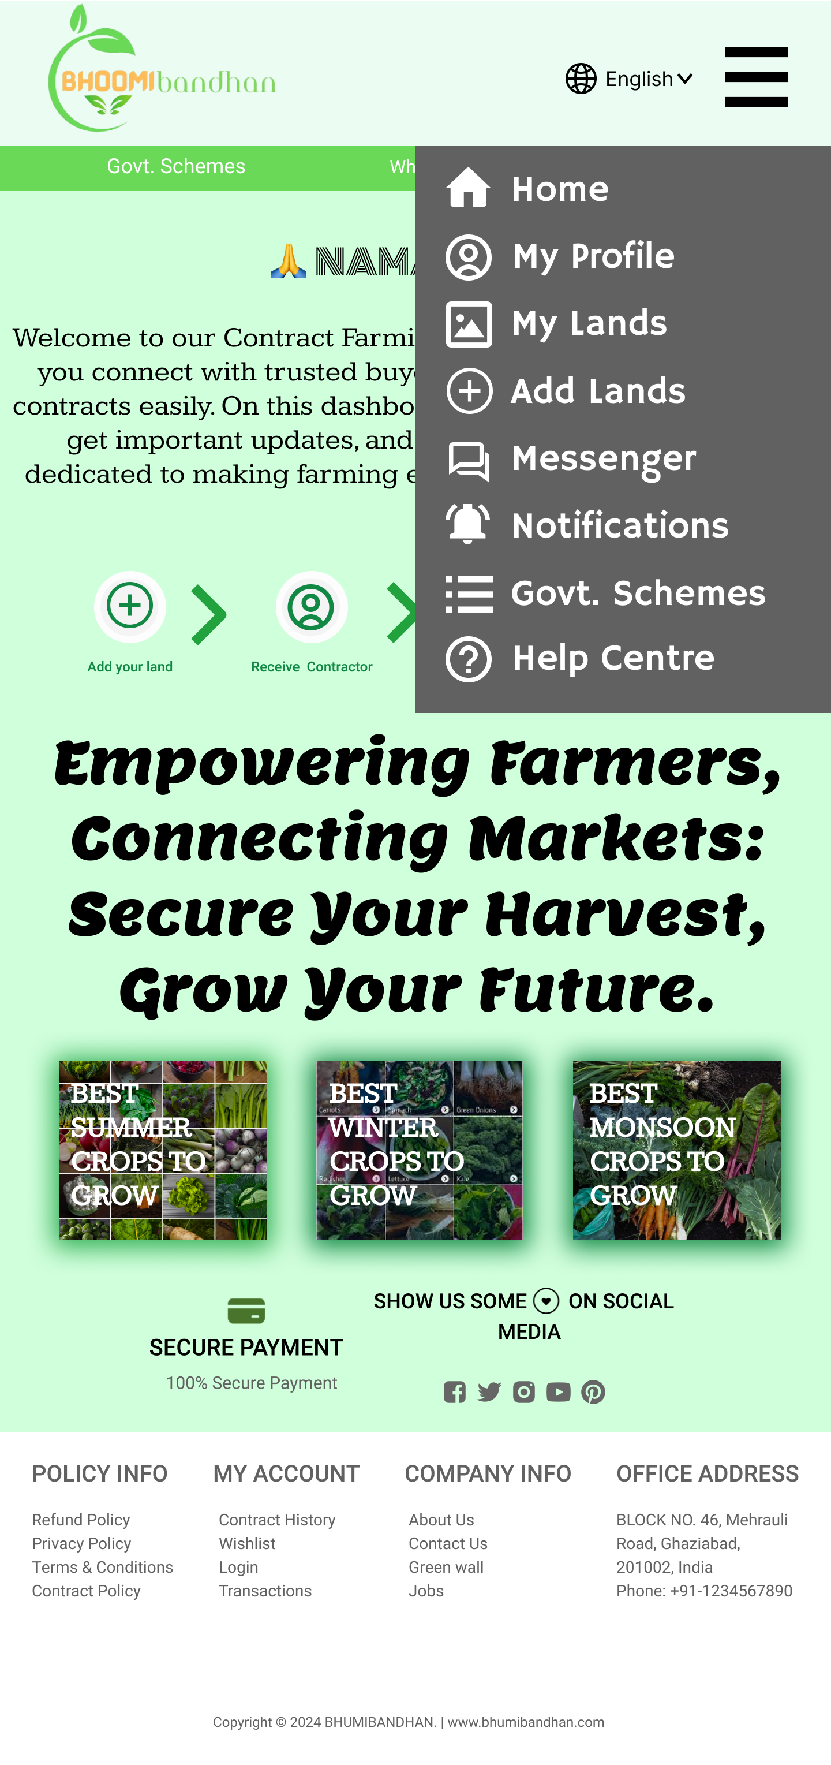
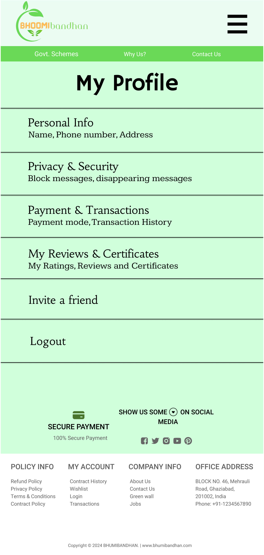
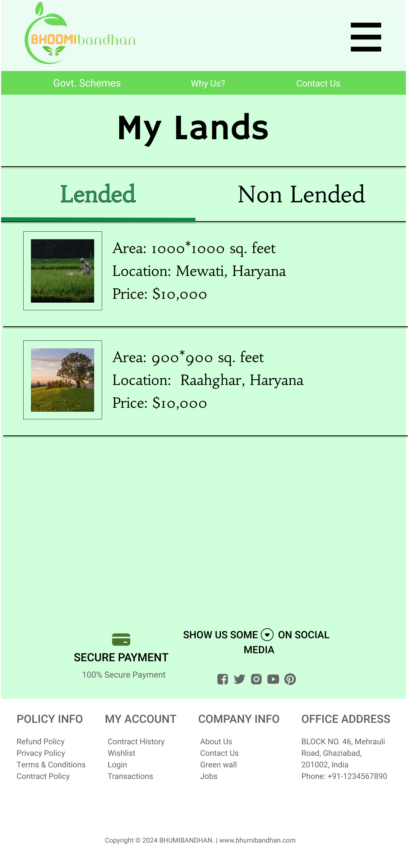

IDEA / SOLUTION APPROACH
As we know that India is the LAND OF FARMERS , but is the condition of farmers in India is actually that good in today’s scenario ? Due to a lot of market fluctuations and discrepancies in the current marketing system, farmers as well as the buyers, both have to face a lot of problems. Recognizing this pressing issue, we, at Team Bhoomi Sahayog, have come together with a revolutionary solution: Bhoomi Bandhan
Idea:
Problem: The current market system in India poses significant challenges for both farmers and buyers due to fluctuations and discrepancies.
Goal: To create a platform that addresses the problems associated with contract farming in India.
Solution Approach:
Bhoomi Bandhan: An innovative website designed specifically for Indian Farmer and contractor.
Features :
Easy registration and login
Negotiation platform
Timed contracts
Increased trust and transparency
Group of Farmers (SAMUH)
PROTOTYPE:

Slide 3
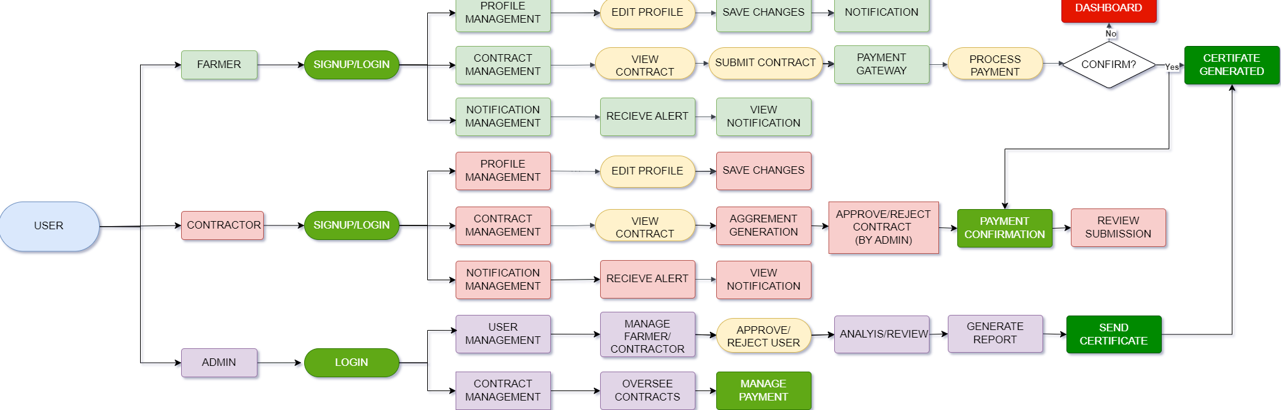
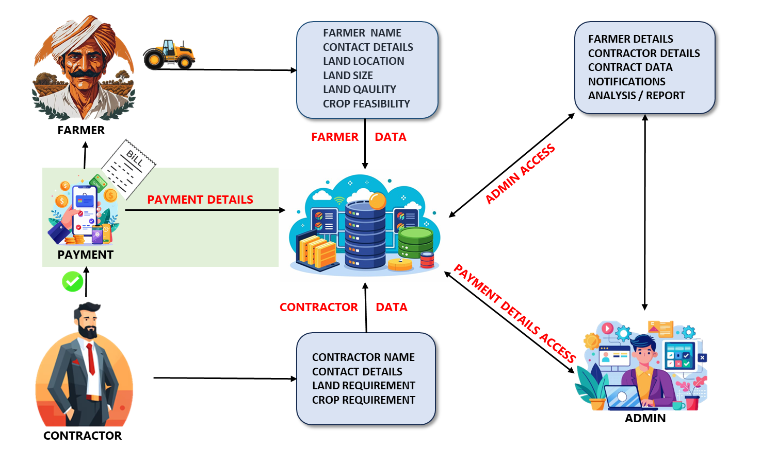





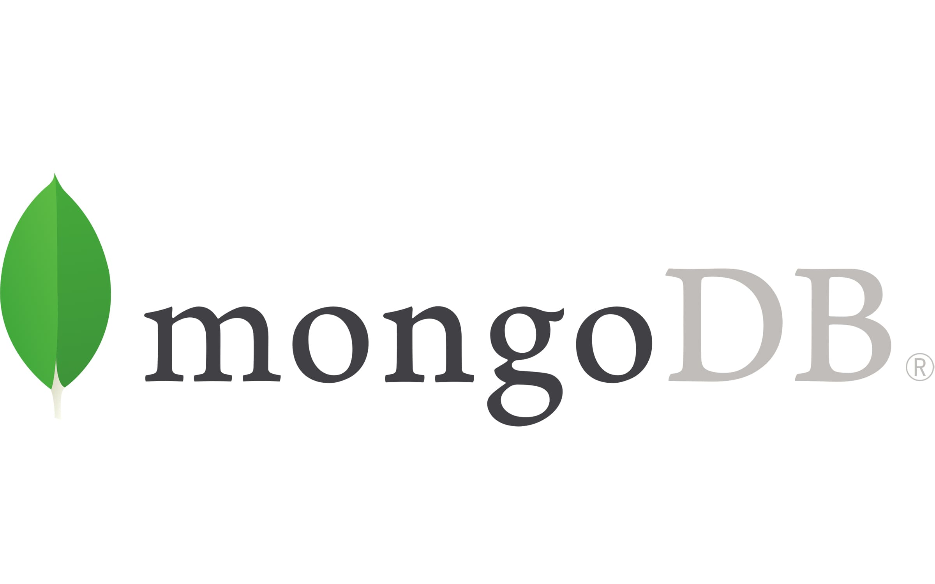







TECHNICAL APPROACH
DATA FLOW DIAGRAM
ACTIVITY FLOW DIAGRAM
TECHSTACK USED
REACT.JS

Slide 4


FEASIBILITY AND VIABILITY
1. Technical Feasibility :
App Viability: Our website is technically sound and capable of fulfilling its intended functions.
Low Input Costs: Development and maintenance costs are minimal, ensuring sustainability.
High Growth Potential: The website's design allows for easy expansion and scalability.
2. Economic Feasibility :
Multiple Revenue Streams: Transaction fees, and value-added services provide diverse income sources.
Opportunities for All: The platform benefits farmers, clients, and government bodies, creating a sustainable ecosystem.
Social Impact: Addresses the challenges faced by Indian farmers by connecting them directly to the market.
3. Social Feasibility :
Farmer Empowerment: Enables farmers to reach the marketplace independently and interact directly with clients.
Government Support: Government bodies play a crucial role in ensuring the platform's success and addressing regulatory requirements.
4. User-Friendly Interface :
Intuitive Design: The website features a clean and user-friendly interface that is easy to navigate.
Accessibility: Designed to be accessible to ordinary Indian farmers without requiring extensive technical knowledge.
Customer Support: Comprehensive customer support ensures a seamless user experience.

Slide 5


IMPACT AND BENEFITS
For Farmers :
Guaranteed Market: Access to a reliable buyer for their produce.
Income Stability: Reduced fluctuations in income due to market uncertainties.
Reduced Stress: Decreased mental stress related to market issues and price discrepancies.
For Buyers :
Consistent Quality: Reliable access to high-quality produce.
Competitive Pricing: Purchase produce at favorable prices.
Increased Profits: Benefit from lower costs and higher margins.
Societal Impact :
Sustainable Market: Promotes a more sustainable and cooperative agricultural market.
Improved Interconnection: Fosters stronger relationships between farmers, buyers.
Enhanced Trust: Encourages trust and transparency in agricultural transactions.
Innovative Features :
Contract Templates: Provides guidance and information on agricultural contracts.
Secure Negotiation Space: Facilitates safe and efficient negotiations between farmers and buyers.
Group Contract Farming (SAMUH): Promotes collaboration among small farmers and facilitates large-scale contracts.

Slide 6
RESEARCH AND REFERENCES
Agri welfare https://agriwelfare.gov.in/en/recruitmentDetail
Khetibuddy https://khetibuddy.com/contract-farming-in-india/
Krishi Unnati https://krishiunnati.org/contract-farming/
FAO(food and agriculture Organization) https://www.fao.org/in-action/contract-farming/en/
Vikaspedia https://vikaspedia.in/agriculture/market-information/contract-farming-a-mechanism-of-alternative-marketing
FARMerp https://www.farmerp.com/verticals/contract-farming
Policy Paper (NATIONAL ACADEMY OF AGRICULTURAL SCIENCES, NEW DELHI)

